Slide 1
Foundation models: pretraining, post-training, model families, reasoning and multimodal models, benchmarks
What is a foundation model, how does it become an assistant, and what does a benchmark score tell me?
Applied AI and Automation | Session 6 of 14
KLAi Professional Learning | Jotham Martin Wambi
Notes:
Welcome to Session 6. Last time you saw how a language model turns logits into probabilities with softmax, how it is trained by measuring a loss on the next token, and how attention lets tokens weigh each other. Today we ask how a model like that becomes the assistant you use, what the main model families are, and how to judge claims about them.
You see one task answered by two assistants, recorded, and you read a real model card.

Slide 2



Today in one view: what you will leave with
By the end of today you will have
Explain pretraining with its average loss and perplexity, and post-training (supervised fine-tuning, RLHF) by the data each uses
Tell apart a base model, an instruction-tuned model, a mixture of experts, a reasoning model, a multimodal model and a diffusion model
Read a model card and a benchmark claim, and compare models on your own work
Notes:
That question gives us three things to be able to do. By the end you can explain pretraining, including the number that measures it, and the two post-training steps by the data each one uses. You can tell the main model families apart. And you can read a model card and a benchmark claim with care, and leave with a comparison grid you can use on your own work.

Slide 3
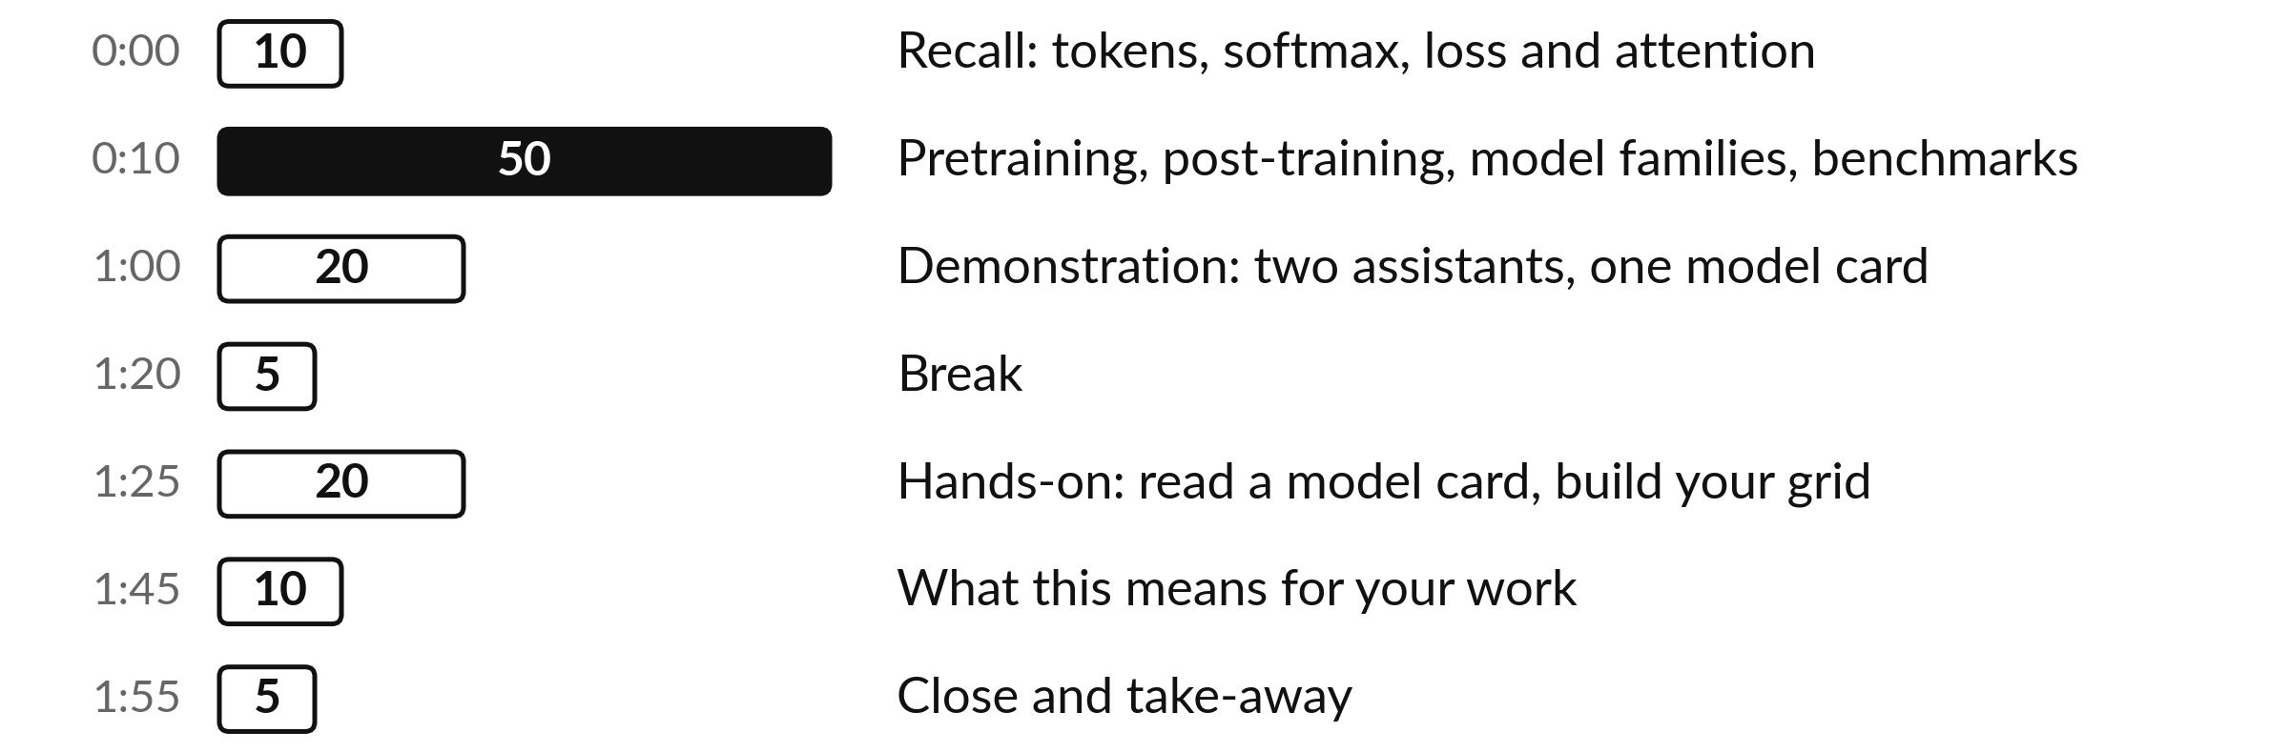
Your two hours: most of
the time is your own work
Ideas built step by step, one task on two assistants, then a real model card on paper.
Notes:
To get there we have two hours. The ideas take fifty minutes this time, because each one is built step by step: how pretraining is measured, the two post-training steps, the main model families, and what a benchmark score can and cannot tell you. Then twenty minutes of demonstration: one task answered by two assistants, recorded, and two real model cards.
After the break you have twenty minutes to read a model card on paper and build a comparison grid, and ten minutes on your own work.

Slide 4

Three questions from last time
1. What does a language model do at each step?
2. How is the loss for one token measured?
3. What does attention do?
Answer aloud first. Then we check together.
Notes:
Three quick questions from Session 5. Answer aloud first, and then we check together. It is a warm-up to bring last time back.
Question one. What does a language model do at each step? Take a moment.
A good answer is this. It gives every token in its vocabulary a score, a logit. Softmax turns the logits into probabilities that add up to 1, and one token is chosen.
Question two. How is the loss for one token measured? Say it to yourself first.
A good answer is this. Minus the natural log of the probability given to the true next token. Days got 0.18, so the loss was −ln 0.18 = 1.71. A sure, right answer gives 0.
Question three. What does attention do? Think about your own work as you answer.
A good answer is this. Each token gives every earlier token a weight by relevance and blends their information, so it can tell which word "it" refers to.
If an answer was missing, last session’s take-away sheet or workbook page has it. Now to today.

Slide 5
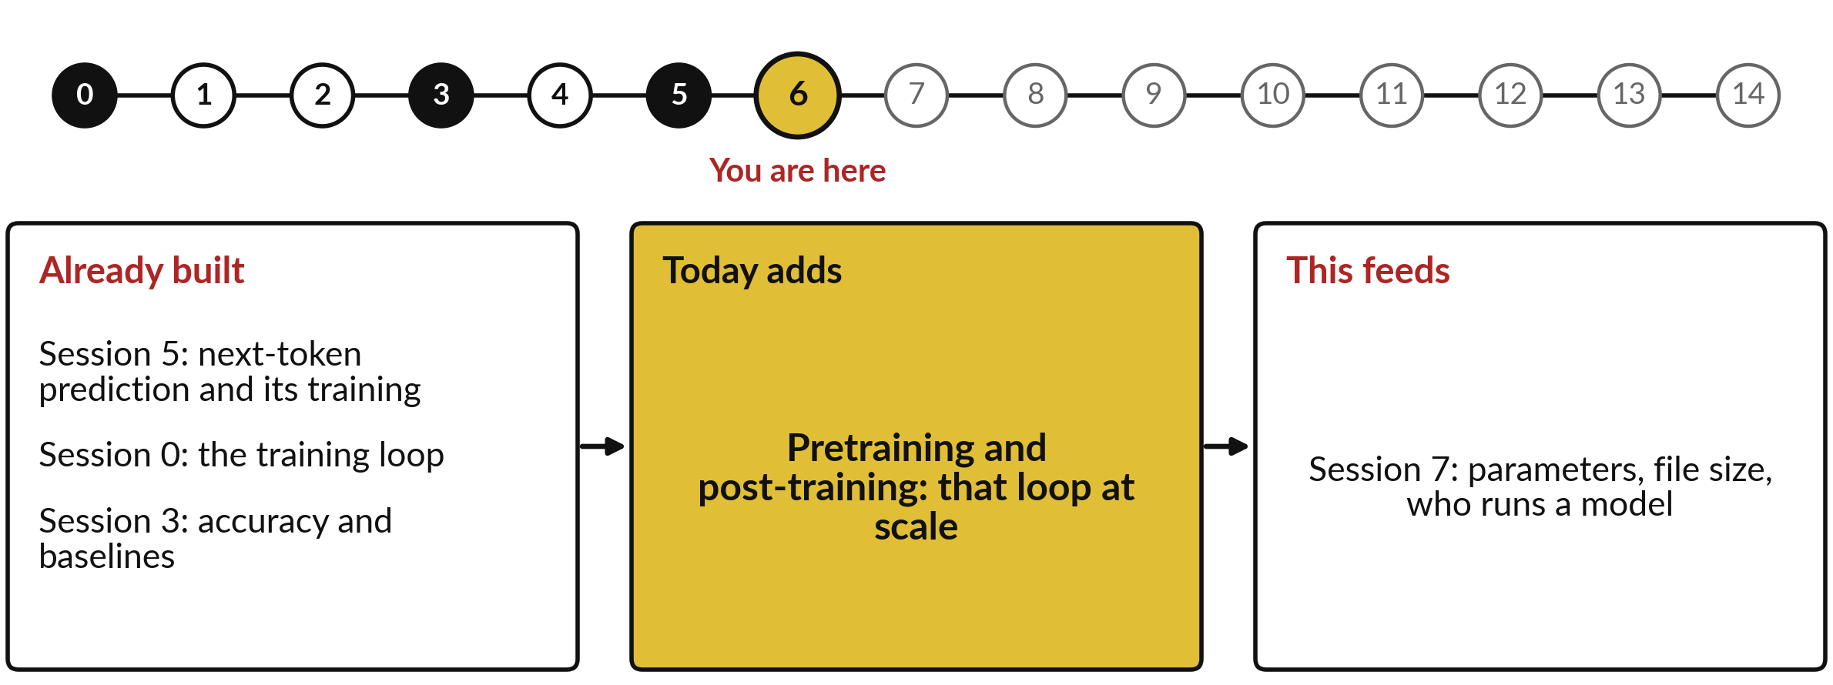
How today connects: what we
already have and what it feeds
Each session is built on the ones before it.
Notes:
So where does today sit in the story? The dots along the top are the fifteen sessions, from the map at Session 0 to your plan at Session 14, and the gold one is today.
We already hold next-token prediction and its training from Session 5, the training loop from Session 0 and accuracy and baselines from Session 3. Nothing today starts from zero.
What today adds is this: pretraining and post-training: that loop at scale.
And it feeds straight into what comes next. Session 7: parameters, file size, who runs a model. Keep that chain in mind, because each idea you learn today is a step on it.

Slide 6





Words we use today
Word | What it means
Pretraining, base model | Next-token prediction on a text corpus, a huge collection of text. The result, a base model, continues text.
Perplexity | e raised to the average next-token loss: as unsure as choosing among that many equally likely tokens. Lower is better.
Post-training: SFT, RLHF | Supervised fine-tuning on answers people wrote, then preference tuning, such as RLHF, on answers people compared.
Model families | Designs built on the same idea: mixture of experts, reasoning, multimodal, diffusion and small language models.
Benchmark, accuracy | A fixed set of questions with an answer key and a scoring rule. Accuracy = correct ÷ total.
Notes:
Five words for today. I give the plain meaning of each, and we use every one of them before the end of the session.
Pretraining, base model. Next-token prediction on a text corpus, a huge collection of text. The result, a base model, continues text.
Perplexity. e raised to the average next-token loss: as unsure as choosing among that many equally likely tokens. Lower is better.
Post-training: SFT, RLHF. Supervised fine-tuning on answers people wrote, then preference tuning, such as RLHF, on answers people compared.
Model families. Designs built on the same idea: mixture of experts, reasoning, multimodal, diffusion and small language models.
Benchmark, accuracy. A fixed set of questions with an answer key and a scoring rule. Accuracy = correct ÷ total.
Keep those words close. The first idea uses them straight away, so let us begin.

Slide 7
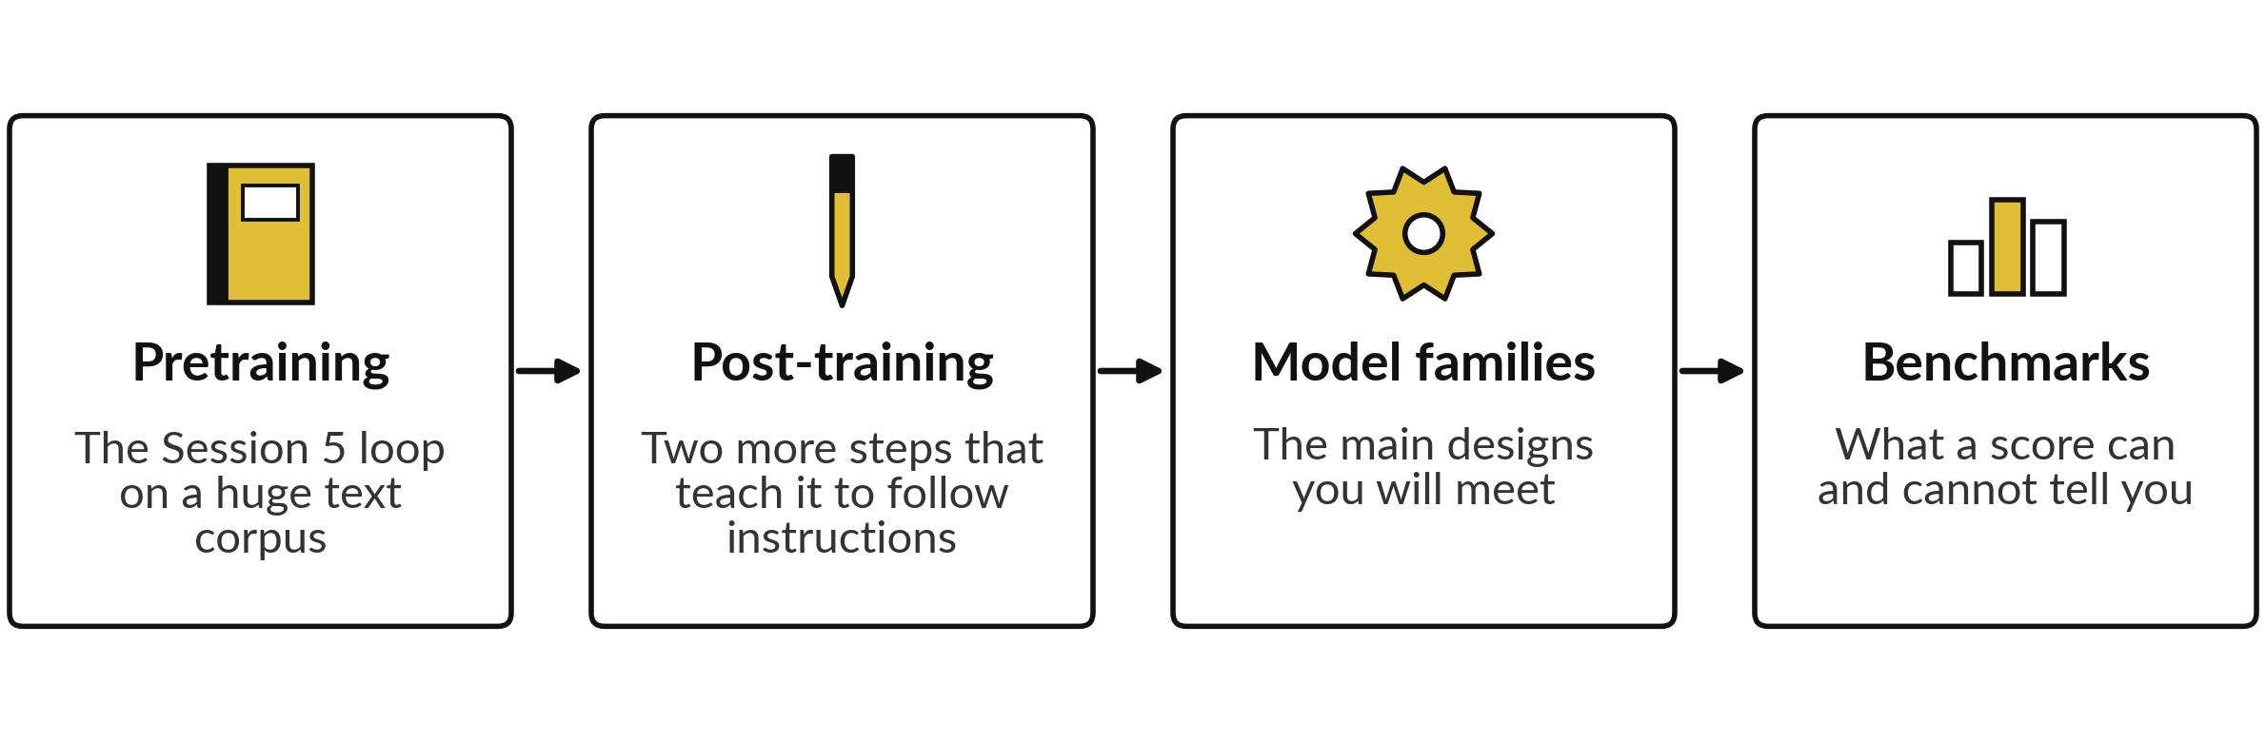
Today in four steps: from the Session 5 model
to the assistant you use, and how to judge it
Each step builds on the one before. The demonstration and the model card come after.
Notes:
Those five words map onto the route we take today. Session 5 gave you one model that predicts the next token and one number, the loss, that says how wrong it was. Today we follow that model through four steps. First, pretraining: the same loop run on an enormous amount of text.
Second, post-training: two further steps that turn a text continuer into an assistant that follows instructions. Third, the families of models built on that idea. Fourth, benchmarks: how models are compared, and why a score can mislead. Each step reuses what came before, so nothing arrives from nowhere. Let us begin with pretraining.

Slide 8
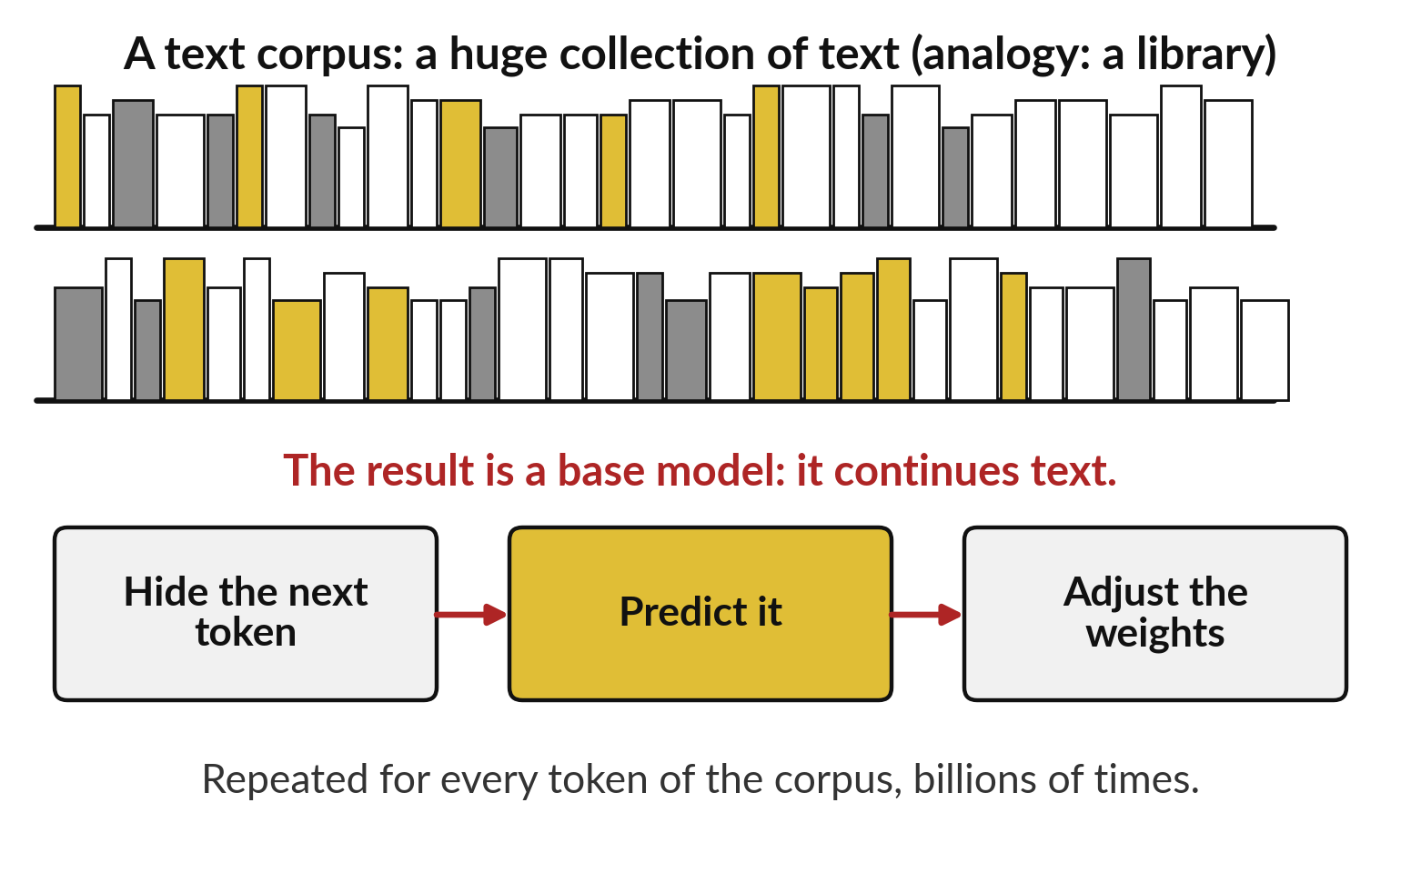
Pretraining is the Session 5
loop run on a huge text corpus
A text corpus is a huge collection of text. Pretraining hides each next token, predicts it and adjusts the weights.
The text is its own label: self-supervised learning, as in Session 0.
GPT-2 read about 40 GB of web text.
The result is a base model, also called a foundation model.
Notes:
In Session 5 the model learned on one sentence: hide the next token, predict it, measure the loss, adjust the weights. Pretraining is exactly that loop. The only new thing is the text. A text corpus is a huge collection of text, such as web pages and books.
Think of a student locked in a vast library with one game: read a passage, cover the next word, guess it, check, adjust. The analogy breaks in one place: the model adjusts numbers and does not understand the books. Nobody labels anything, because the next token in the text is the answer.
Session 0 called that self-supervised learning. GPT-2 read about 40 gigabytes of web text, roughly 40 billion letters. The result is a base model, also called a foundation model, because many products are built on it. How big do these models get?

Slide 9
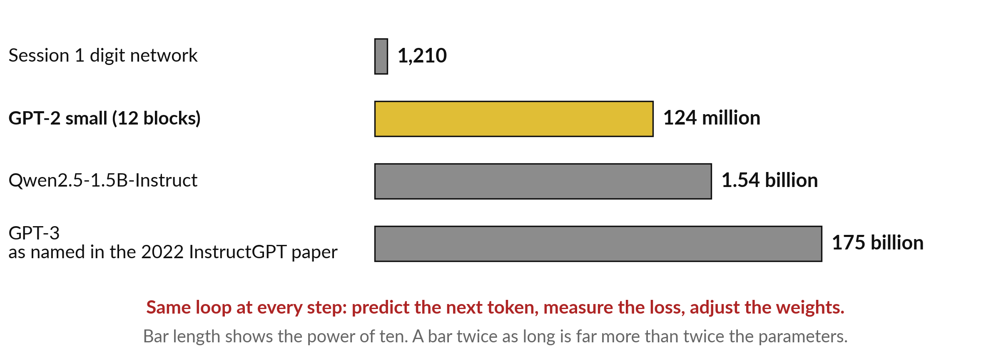
Pretraining at scale is the same loop with
more parameters: 124 million to 175 billion
Published figures only. Parameters: weights and biases. LLM: large language model.
Notes:
Here is the build-up in numbers. In Session 1 you met a small digit network with 1,210 parameters, the weights and biases that training adjusts. GPT-2 small, from Session 5, has 12 transformer blocks and about 124 million. Qwen two point five, one point five billion has one point five four billion, from its model card.
The 2022 InstructGPT paper names GPT-3 at 175 billion. A model with billions of parameters, pretrained on a corpus like this, is called a large language model, or LLM. Each bar shows how many times you multiply by ten, so a bar twice as long is far more than twice the parameters.
I state no size for any closed assistant, because the makers have not published one. With so many tokens read, how do engineers know pretraining is going well?

Slide 10
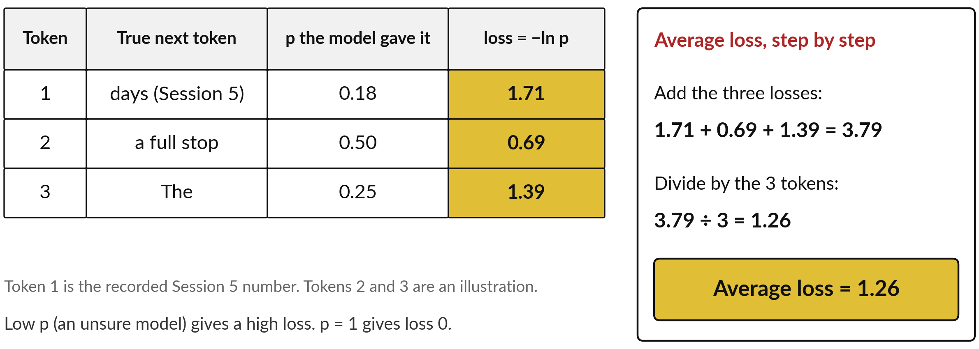
Pretraining tracks one number: the
next-token loss averaged over many tokens
Each token has its own loss. The average shows how training is going: lower is better.
Notes:
The answer is one number, and you already know its parts. In Session 5 the model gave the true next token, days, a probability of 0.18, and the loss was minus the natural log of 0.18, which is 1.71. A loss is high when the model was unsure of the right token and zero when it was sure and right.
Pretraining has billions of tokens, each with its own loss, so we need one summary: the average. Take three tokens. The first is the recorded days. The other two are an illustration: a full stop that got 0.50, loss 0.69, and the word The that got 0.25, loss 1.39.
Add the three losses: 3.79. Divide by the three tokens: 1.26. That average falls as pretraining goes well. How would we write it for billions of tokens?

Slide 11
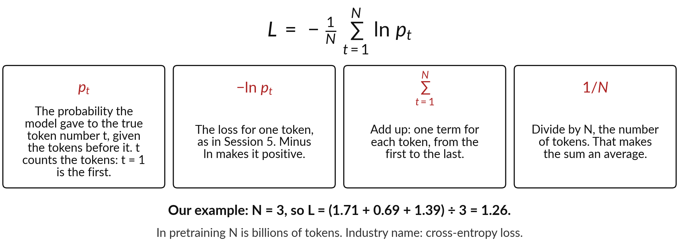
The average loss as a formula: add the
loss of every token, then divide by N
Σ means add up, one term for each token. N is the number of tokens.
Notes:
Here is the same sum in standard notation, as you will meet it in papers. L is the average loss. The small t counts the tokens: t equals one is the first token, t equals two the second, up to N, the number of tokens. p sub t is the probability the model gave to the true token number t, given the tokens before it.
Minus ln p sub t is the loss for that one token, as in Session 5. The Greek letter sigma means add up, one term for each token from the first to the last. Then one over N divides by the number of tokens, which turns the sum into an average.
In our example N is three, so L is 3.79 divided by 3, which is 1.26. The industry name is cross-entropy loss.

Slide 12
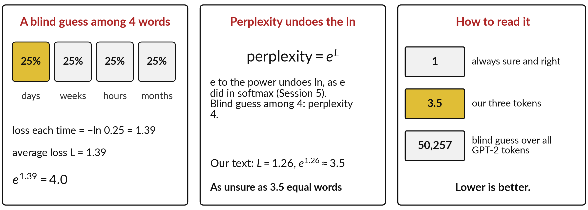
Perplexity is e raised to the average loss: as
unsure as choosing among that many equal tokens
Perplexity = e^L: a count of equally likely choices. Lower is better.
Notes:
A loss of 1.26 is hard to picture, so engineers turn it into a count, called perplexity. Imagine a model blind between four words, days, weeks, hours and months, giving each 25 percent. Its loss is then minus ln of 0.25, 1.39, every time, so the average is 1.39.
Now raise e to that power. In Session 5, e to a power appeared in softmax, and it undoes the natural log: e to the 1.39 is 4. So a blind choice among four words gives perplexity four. So perplexity counts how many equally likely words the model is as unsure as.
Our average of 1.26 gives e to the 1.26, about 3.5. One is perfect; a blind guess over all 50,257 GPT-2 tokens gives 50,257. Lower is better. But what does such a model do with a task?

Slide 13
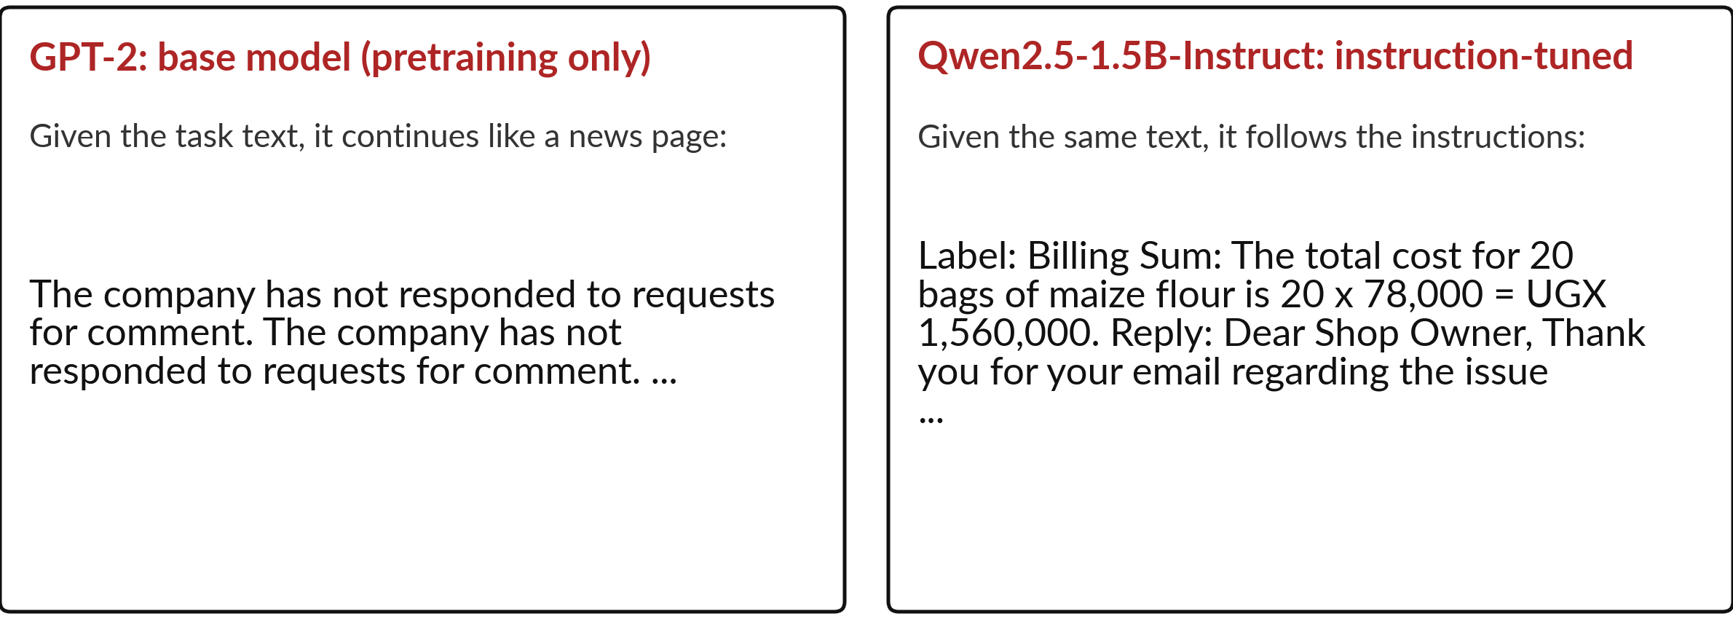
A base model only continues
text: the same task, two real runs
Real runs, 6 Nov 2026. Greedy decoding: always the top token (Session 5).
Notes:
Here is what a low pretraining loss buys you, and what it does not. I gave two models the same task text, about a damaged delivery at Nile Valley Foods, a food company we use as our example. I ran both with greedy decoding, which always takes the top token, as in Session 5.
On the left, GPT-2 is a base model: pretraining only. It treats the text as the start of a news page and writes the company has not responded to requests for comment, over and over. It continues text well, and that is all it learned to do. On the right, Qwen two point five, one point five billion Instruct, a small open model, follows the three instructions: a label, a sum and a reply.
What happened to the second model after pretraining?

Slide 14
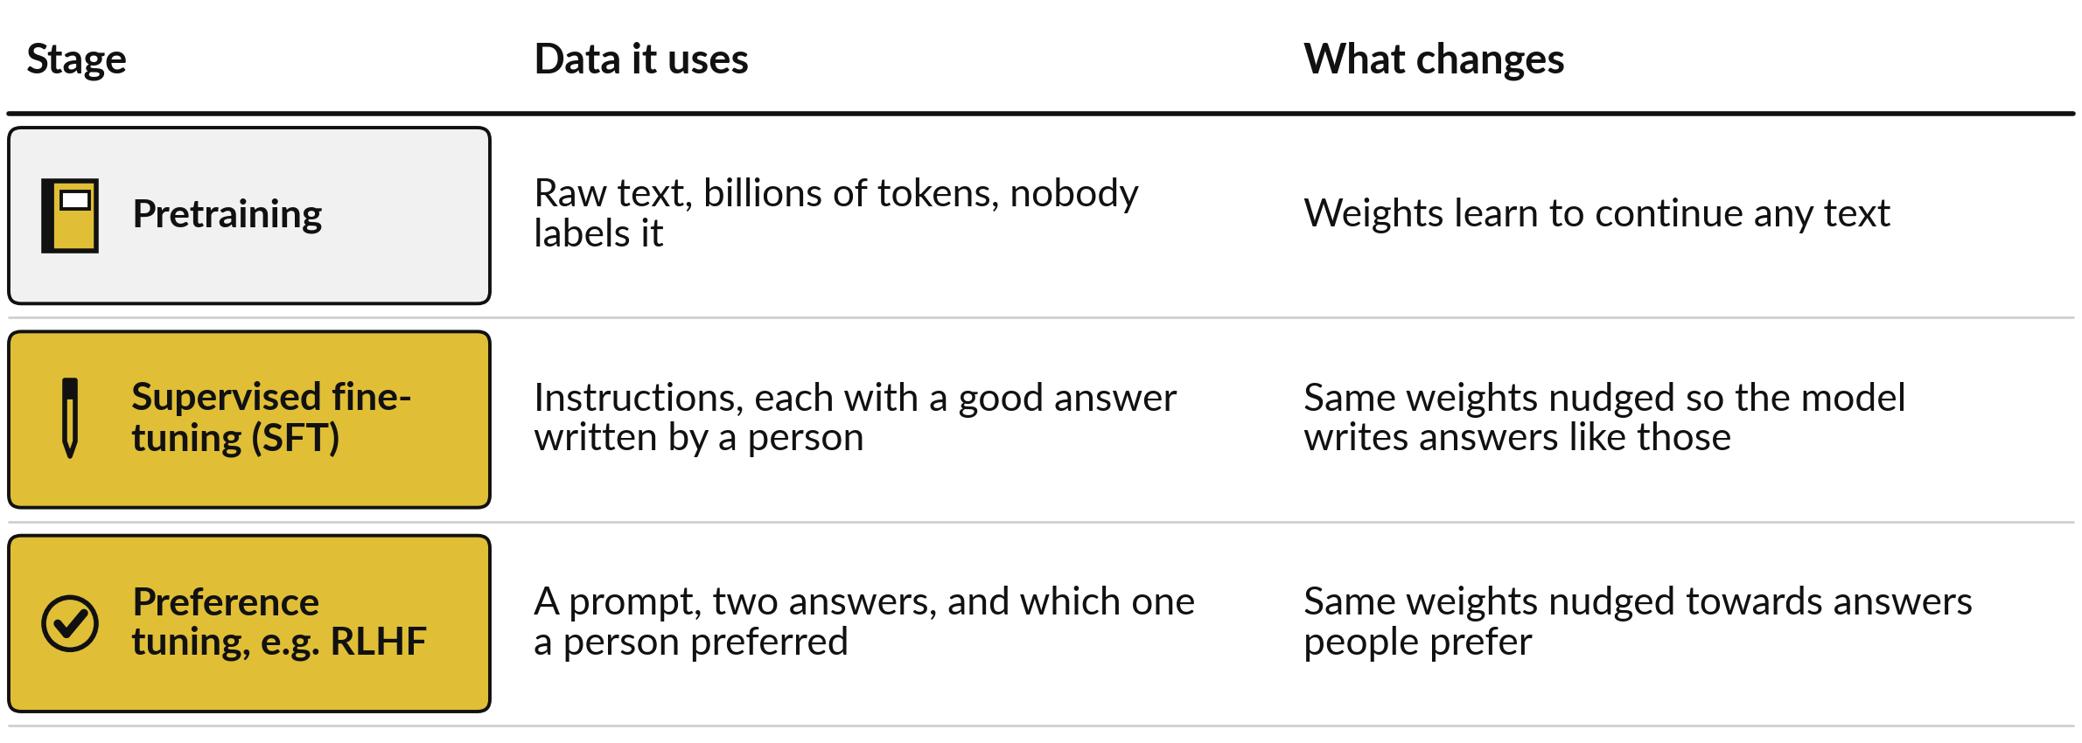
Post-training: two more steps on the
same weights, each with its own data
Post-training adjusts the pretrained weights. Each step learns from different data.
Notes:
What happened is post-training. It keeps the pretrained weights and adjusts them further, and each step is defined by the data it learns from. Pretraining used raw text that nobody labelled, and the weights learned to continue any text. The first post-training step, supervised fine-tuning, or SFT, uses instructions, each paired with a good answer that a person wrote.
The weights are nudged so the model writes answers like those. It is also called instruction tuning. The second step, preference tuning, uses a prompt, two answers and the answer a person preferred. The weights are nudged towards answers people prefer. The best-known method is RLHF, reinforcement learning from human feedback. Let me take each step in turn, starting with supervised fine-tuning.

Slide 15
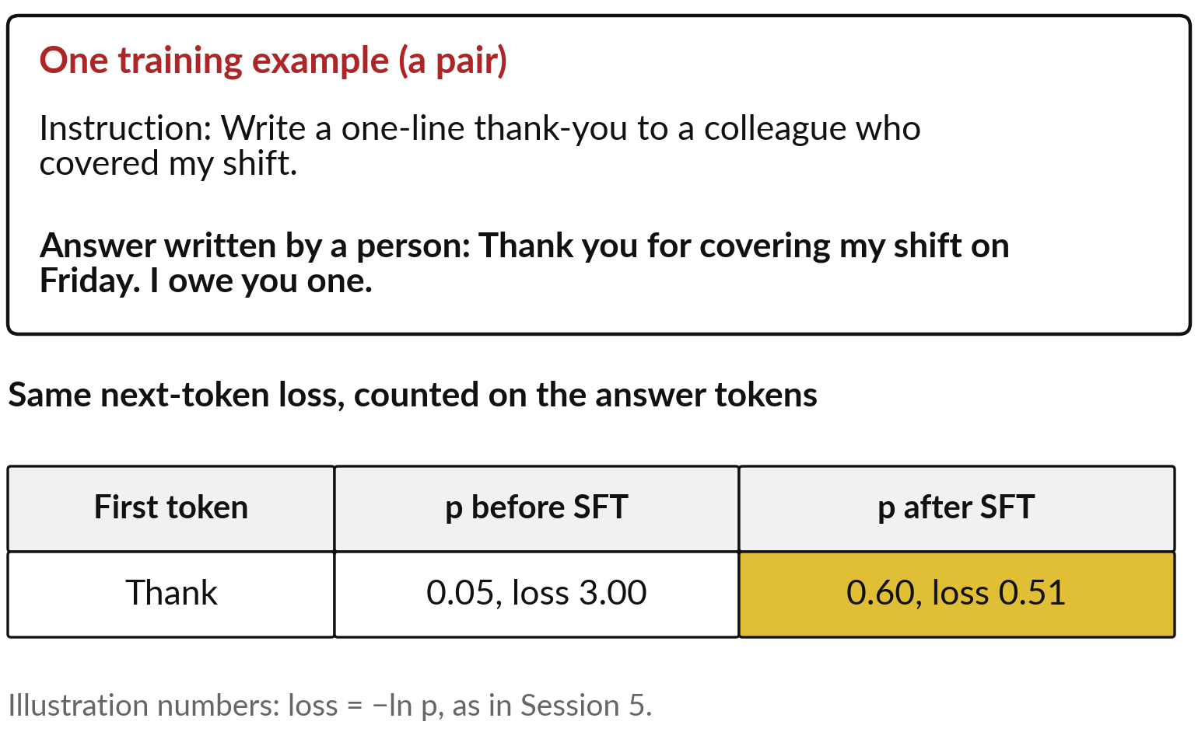
Supervised fine-tuning: the same
loss, now on answers people wrote
The data is pairs: an instruction and a good answer written by a person.
The loss is counted on the answer tokens.
Training raises the probability of answers like the ones people wrote.
Also called instruction tuning.
Notes:
Supervised fine-tuning is supervised in the Session 0 sense: every example comes with the right answer. One example is a pair. The instruction says write a one-line thank-you to a colleague who covered my shift. The answer, written by a person, says thank you for covering my shift on Friday, I owe you one.
The model is trained with the same next-token loss as before, only now the loss is counted on the answer tokens. Take the first answer token, Thank. Before fine-tuning, say the model gave it 0.05, a loss of 3.00. After many such pairs, say it gives 0.60, a loss of 0.51.
Those are illustration numbers. Across many pairs the model learns the habit of answering. But writing good answers by hand is slow. Is there a cheaper signal?

Slide 16
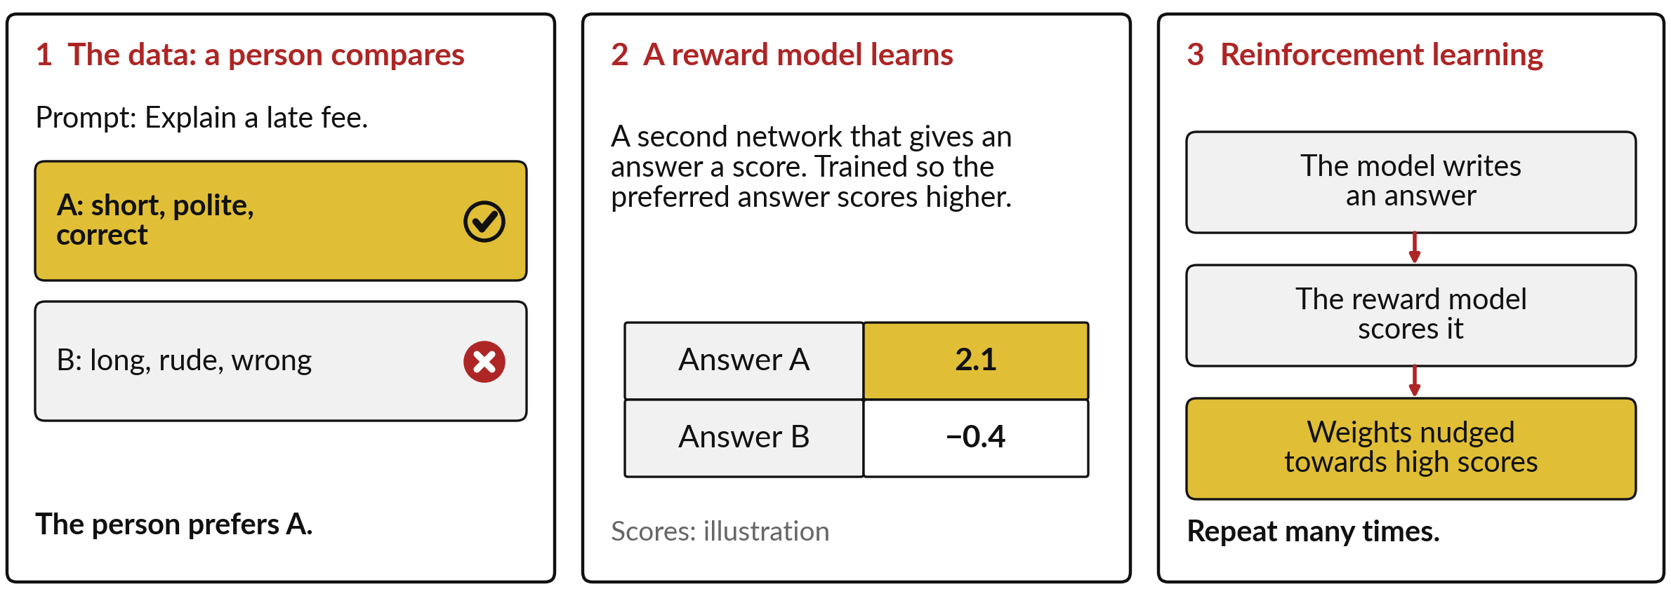
Preference tuning with RLHF: people compare two
answers, a reward model learns, the model is nudged
RLHF: reinforcement learning from human feedback. InstructGPT (2022) used SFT, then RLHF.
Notes:
There is: it is easier to pick the better of two answers than to write one. That is the data for preference tuning. A person sees a prompt, explain a late fee, and two answers, and picks A. With many such choices, a reward model is trained: a second network that gives any answer a score, trained so that the preferred answer scores higher, here 2.1 against minus 0.4, illustration numbers.
Then comes reinforcement learning, from Session 0: learning by trial and reward. The model writes an answer, the reward model scores it, and the weights are nudged towards higher scores, many times over. That whole process is RLHF. The 2022 InstructGPT paper found people preferred a 1.3 billion model trained this way over the 175 billion GPT-3. Post-training can matter as much as size.

Slide 17
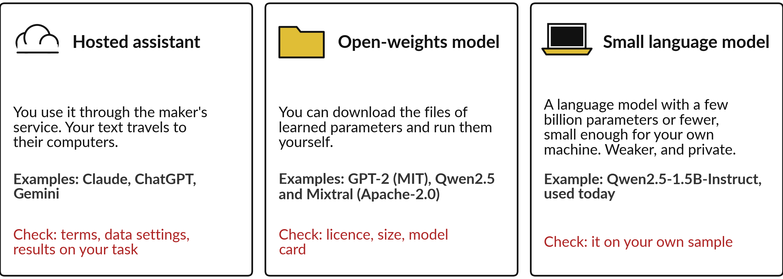
Three kinds you will meet: hosted assistants,
open-weights models and small language models
Licence: the legal permission to use a model. Session 7 covers licences.
Notes:
Now you know how a model is made, so we turn to sorting the models you will meet, starting with the three you can actually reach. A hosted assistant runs on its maker computers. You send text and get text back, so you check the terms and data settings.
Examples are Claude, ChatGPT and Gemini, and I say nothing about their insides, because their makers have not published them. An open-weights model is one whose learned parameters you can download and run, under a licence, the legal permission that says what you may do with it. GPT-2 is under the MIT licence, Qwen two point five and Mixtral under Apache two point zero.
A small language model has a few billion parameters or fewer, small enough for a laptop. Inside some large models there is a design worth a picture.

Slide 18
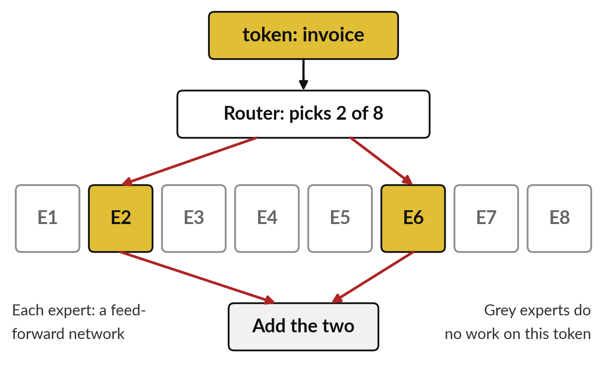
Mixture of experts: a router sends
each token to two of eight experts
Each expert is a feed-forward network. Only the two chosen experts work on a token.
Why: less computing for each token.
Mixtral (2024): 8 experts per layer, 2 per token.
About 47 billion parameters stored, about 13 billion used per token.
Notes:
The design is called mixture of experts, or MoE. In Session 5 each transformer block had a feed-forward network, a small stack of neuron layers that every token passes through. In a mixture of experts, one block holds several feed-forward networks, called experts, here eight. A small router looks at each token and sends it to just two of them.
The grey ones do no work on that token. As an analogy, think of a hospital reception sending each patient to two of eight teams. The analogy breaks: the experts are not specialists in any human subject. Why do it?
Each token needs only a quarter of the experts computing. The Mixtral paper of January 2024 reports about 47 billion parameters stored and about 13 billion used for each token. But how does the router combine the two answers?

Slide 19
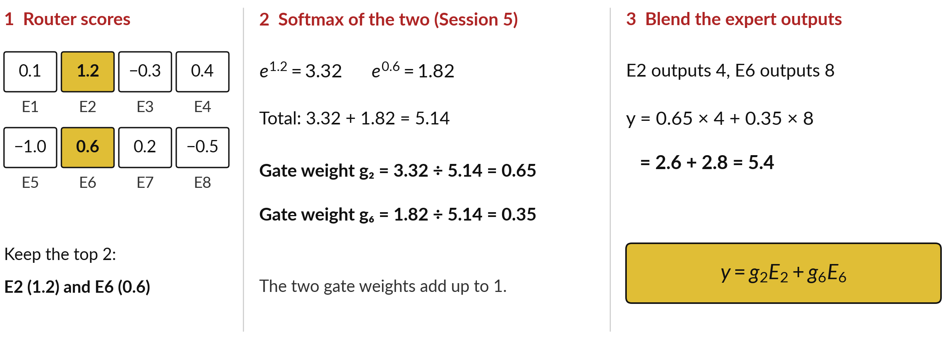
The gate weights, worked: softmax of the
two top router scores, then a weighted blend
y = Σ gᵢEᵢ over the chosen experts. g: gate weight. E: expert output (one number here).
Notes:
It uses tools you already have. The router scores each of the eight experts, like a logit. Experts 2 and 6 score highest, 1.2 and 0.6, so the others are dropped. Softmax from Session 5 turns these into weights: e to the 1.2 is 3.32, e to the 0.6 is 1.82, the total is 5.14, so the gate weights are 3.32 divided by 5.14, which is 0.65, and 0.35.
They sum to one. Say the experts output 4 and 8. Weight and add: 0.65 times 4 is 2.6, 0.35 times 8 is 2.8, total 5.4. In symbols, y equals g two E two plus g six E six, or sigma of g i E i over the chosen experts.
A real expert outputs a list of numbers, blended the same way.

Slide 20
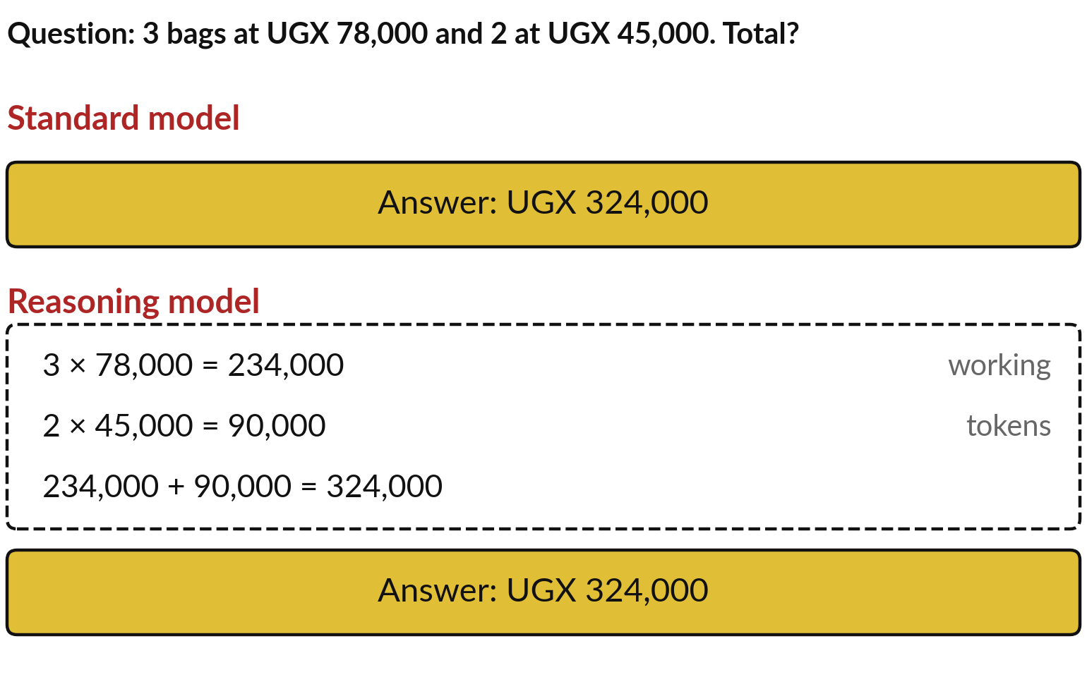
Reasoning models write out
working tokens before the answer
They spend extra tokens on intermediate steps, which can help on multi-step problems.
DeepSeek-R1 (2025) used reinforcement learning, rewarding correct answers on checkable tasks.
More tokens: slower and dearer per answer.
Notes:
A different change is in how a model answers. A reasoning model writes out intermediate steps as tokens before the answer. Take three bags at UGX 78,000 and two at UGX 45,000. A standard model writes the total straight away. A reasoning model first writes three times 78,000 is 234,000, two times 45,000 is 90,000, and the sum, 324,000, then the answer.
Each written step becomes context for the next token, so a long problem is broken into short ones. The DeepSeek-R1 paper, published in Nature in 2025, describes training this with reinforcement learning that rewarded correct answers on tasks that can be checked, such as maths and code. I describe the published idea only, nothing about closed products.
Because it writes more tokens, it is slower and dearer. Session 8 shows when to choose one.

Slide 21
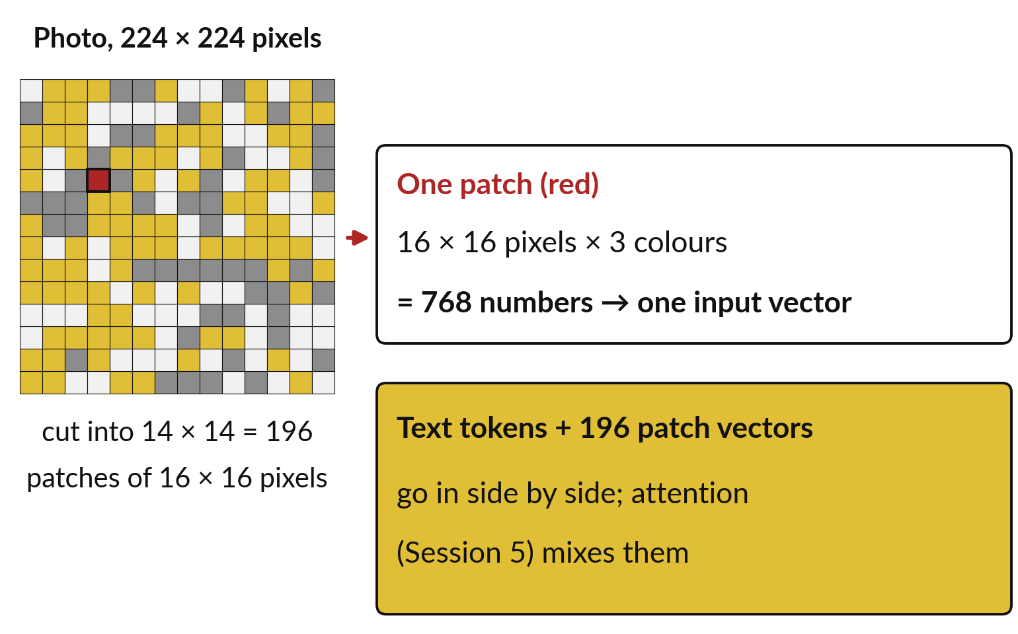
Multimodal models cut a photo into
patches and treat each patch like a token
A multimodal model takes more than text, for example photos or sound, beside the text tokens.
A pixel is three numbers (Session 1), so a patch is a list of numbers.
Example sizes; methods differ between models.
Notes:
Models can also be taught to take in more than text. A multimodal model accepts photos or sound too. The trick is to turn a photo into something that looks like tokens. In Session 1 a colour pixel was three numbers, red, green and blue. Take a photo of 224 by 224 pixels and cut it into squares of 16 by 16 pixels, called patches: that gives 14 by 14, which is 196 patches.
One patch holds 16 times 16 pixels times 3 colours, 768 numbers, and the model turns those into one input vector, like the embedding row of a token in Session 5. The text tokens and the 196 patch vectors go in side by side, and attention mixes them.
These sizes are one common example, and methods differ. This is how an assistant can read a photo of a receipt. It can still misread a blurry figure.

Slide 22
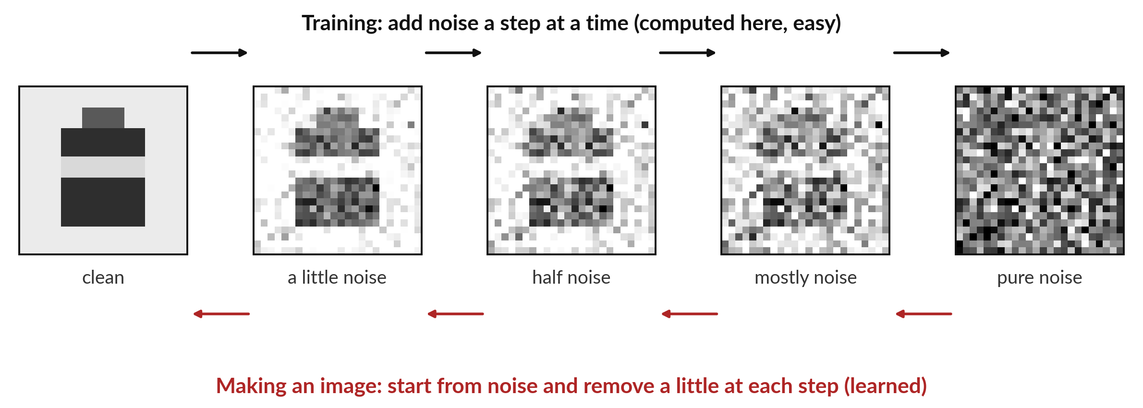
A diffusion model makes images
by removing noise step by step
Noise: random numbers added to each pixel. DDPM (2020) learns the reverse path.
Notes:
Some models go the other way and make pictures rather than read them. Image generators of the diffusion kind work with noise, which here means random numbers added to every pixel, so the picture turns to speckle. In training, a clean picture is damaged step by step until only noise remains.
That direction is easy, and I computed this row myself from a simple picture of a sack. The model learns the reverse: given a noisy picture, remove a little noise. To make a new image, start from pure noise and apply that learned step many times. The foundational paper is Denoising Diffusion Probabilistic Models, DDPM, from 2020.
One sentence is enough for most executives: a diffusion model turns noise into a picture, step by step. That completes the families, and it leaves one question: how do people compare them?

Slide 23
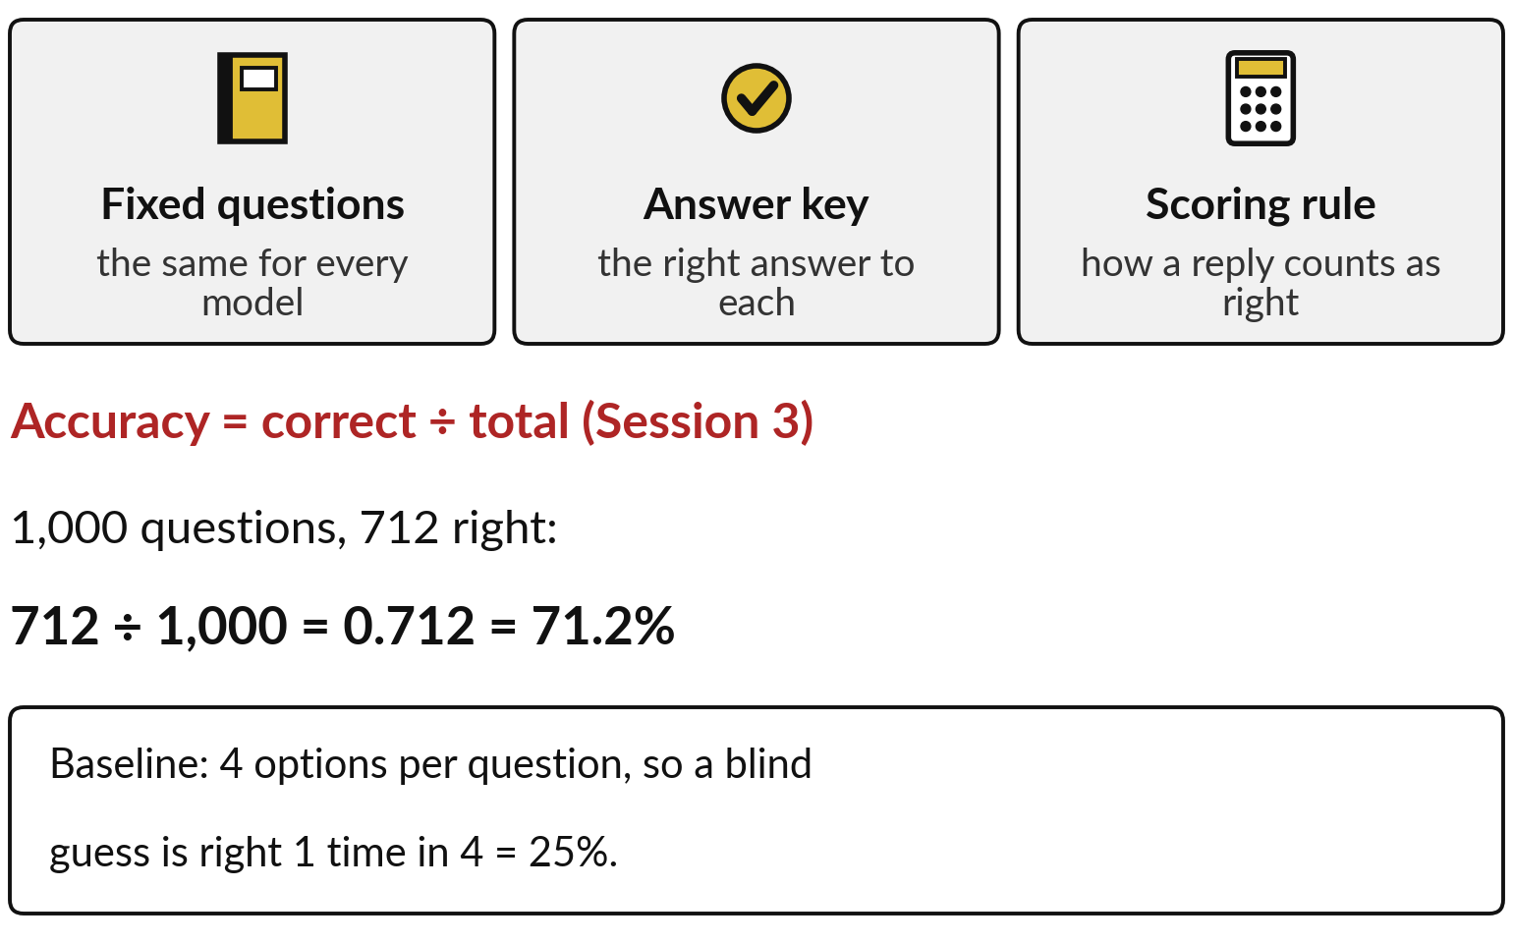
A benchmark is fixed questions, an answer key
and a scoring rule; accuracy is correct ÷ total
Every model answers the same questions, so the scores can be compared.
Accuracy as in Session 3: 712 ÷ 1,000 = 71.2%.
Baseline: with four options, blind guessing gets 25%.
Notes:
Every vendor pitch quotes benchmark scores, so this is the last idea block, and it protects your budget. A benchmark has three parts: a fixed set of questions, the same for every model; an answer key with the right answer to each; and a scoring rule that says when a reply counts as right.
Most benchmarks report accuracy, as in Session 3: the number correct divided by the total. Say a benchmark has 1,000 questions and a model gets 712 right. 712 divided by 1,000 is 0.712, which is 71.2 percent. Always compare with a baseline, the score of a simple guess.
If each question has four options, a blind guess is right one time in four, 25 percent. So 71.2 percent is well above chance. Which benchmarks will you see?

Slide 24
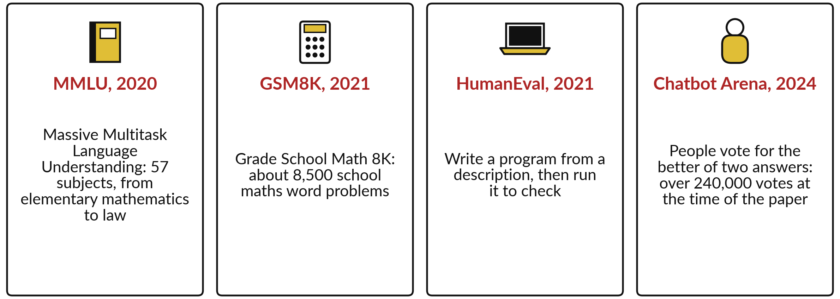
Four benchmarks you will see in vendor material
Facts from the original papers. Each measures something narrow and real.
Notes:
Here are four names that come up again and again. MMLU, Massive Multitask Language Understanding, from 2020, has multiple-choice questions in fifty-seven subjects, from elementary mathematics to law, scored by accuracy. GSM8K, Grade School Math 8K, from 2021, has about eight and a half thousand school maths word problems, and the final number must match.
HumanEval, from 2021, asks a model to write a program from a description, and the scoring rule runs the program to check it. Chatbot Arena, from 2024, is different: people vote for the better of two anonymous answers, and the ranking comes from the votes. Each one measures something narrow and real. Now, two ways in which a score can mislead you.

Slide 25
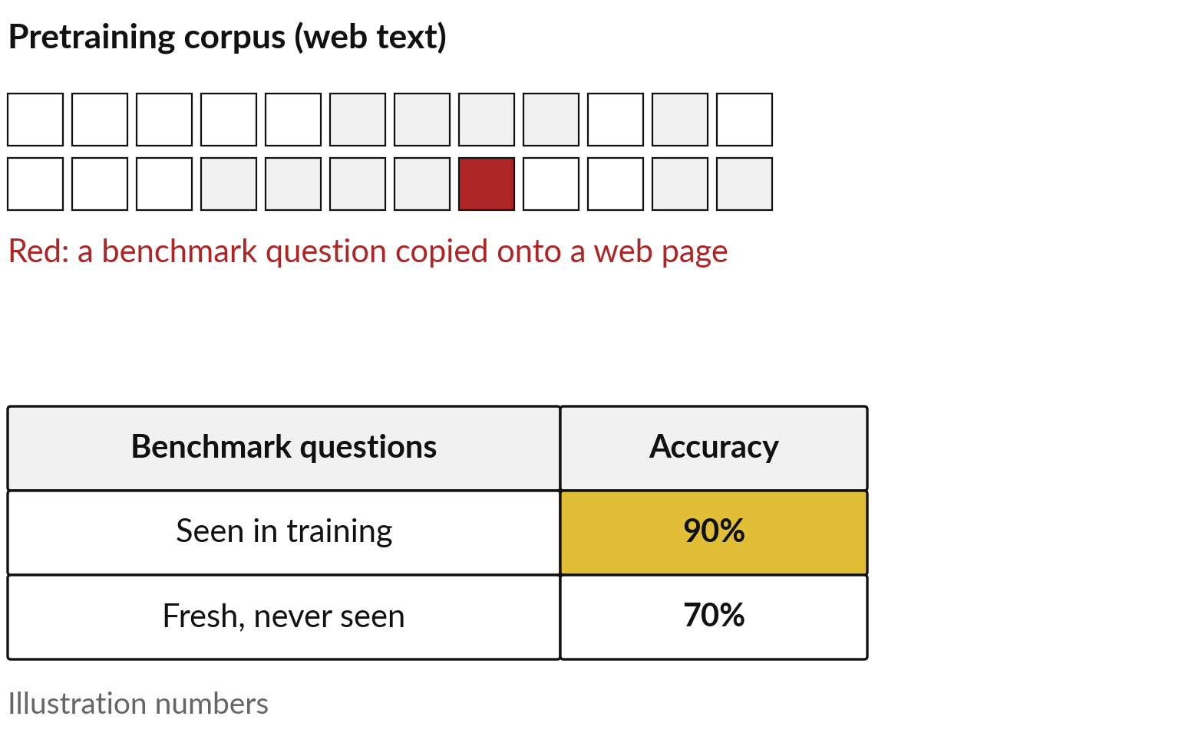
Scores mislead when benchmark
questions leaked into the training text
This is called contamination: the model may have seen the questions in pretraining.
As in Sessions 0 and 1, a test set must stay unseen.
Outsiders often cannot check the corpus.
Notes:
The first way is called contamination. Benchmark questions are published, and copies end up on web pages. If those pages were in the pretraining corpus, the model may have seen the questions, and perhaps the answers, before it was scored. Think of a student who saw the answer sheet the night before.
Sessions 0 and 1 gave you the rule behind this: a test set must stay unseen, or its score says nothing about new cases. In the illustration, the same model gets 90 percent on questions that leaked and 70 percent on fresh ones. Makers try to remove leaked questions, and some publish checks, but outsiders often cannot see the corpus to confirm it. The second way a score misleads is quieter.

Slide 26
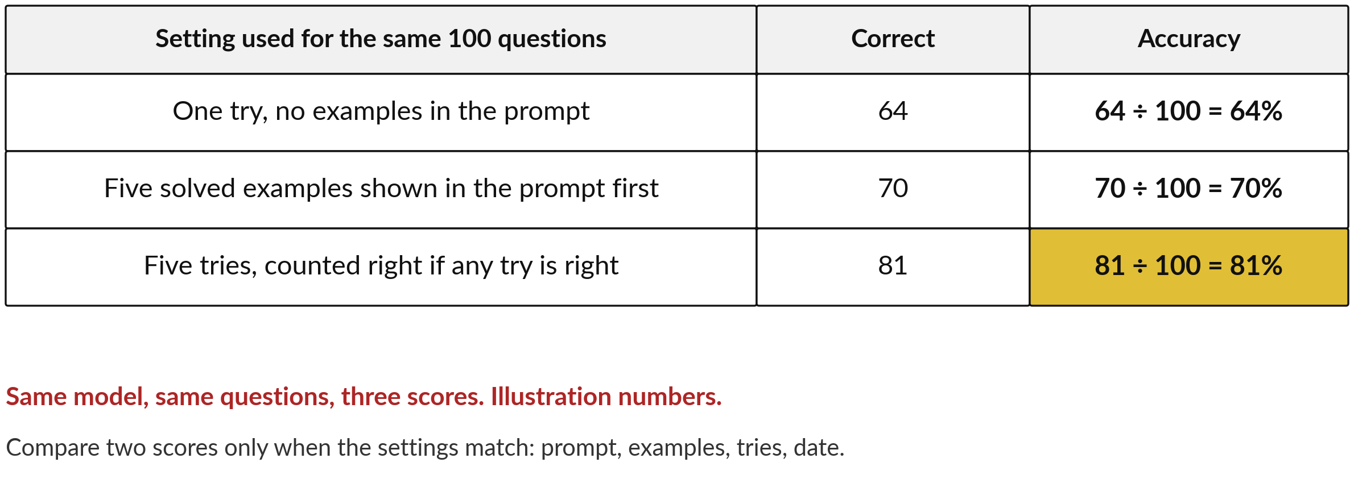
Scores mislead when the settings
differ: one model, three scores
A prompt is the text given to the model. Session 8 covers prompting.
Notes:
It is the settings. The same model on the same 100 questions can earn very different scores depending on how it was asked and how it was counted. With one try and no examples in the prompt, the text given to the model, say it gets 64 right: 64 percent.
Show it five solved examples first and it gets 70. Allow five tries and count the question right if any try is right, and it gets 81. These are illustration numbers, but each setting is used in published reports. So when a vendor says 81 against a rival 70, ask which prompt, how many examples, how many tries, and on what date.
Compare two scores only when the settings match. Even then, one more gap remains.

Slide 27
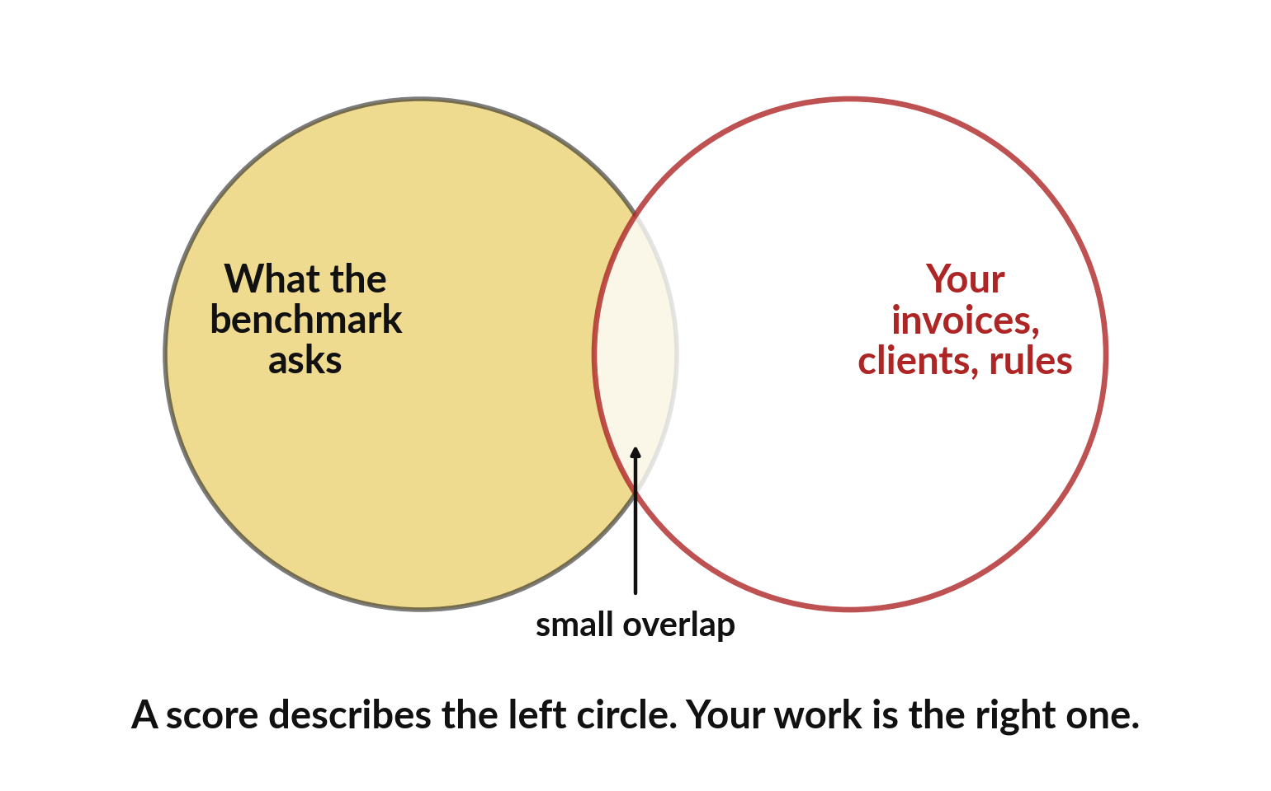
A benchmark describes its own
questions; your work is a different circle
A high score is a reason to test on your own cases. It is no reason to buy.
Ask for the setup: prompt, examples, tries, date.
Ask about contamination checks.
Votes can reward a pleasant style over accuracy.
Notes:
That gap is your own work. A benchmark describes how a model did on its questions. It does not tell you whether the model suits your invoices, your clients and your rules, and the two circles overlap only a little. So from the last two slides you have three questions to ask: what was the setup, what checks were made for contamination, and, for vote-based rankings, could a pleasant style have won the votes rather than accuracy.
A high score is a good reason to run your own test, and a poor reason to sign a contract. Your own ten-case sample, scored by you, is stronger evidence. Let me show you what such a test looks like.

Slide 28
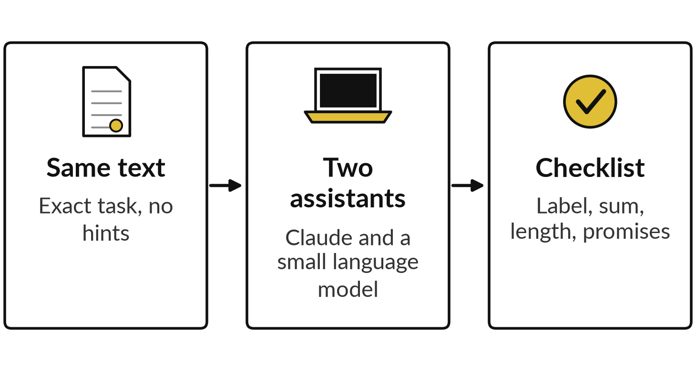
Demonstration: one task, two assistants, recorded
I will show
Watch for
The task asks for a label, a sum and a short reply.
Both get the same text and nothing else.
Look for invented promises.
The small language model is not ChatGPT or Gemini.
Notes:
A score is a claim, and a test on your own work is evidence, so here is one task answered by two assistants, recorded. The task is the one on screen: a shop owner reports three wet and torn bags, mentions a payment, and asks what we will do.
Both assistants got exactly the same text. Claude answered in a fresh session, with no hints. The other is Qwen two point five, one point five billion Instruct, a small language model that I ran on this laptop, three times. Be fair to it: it is a small model, and it is not ChatGPT, Gemini or Claude.
We score each reply on a checklist, and you watch especially for promises the company never made.

Slide 29
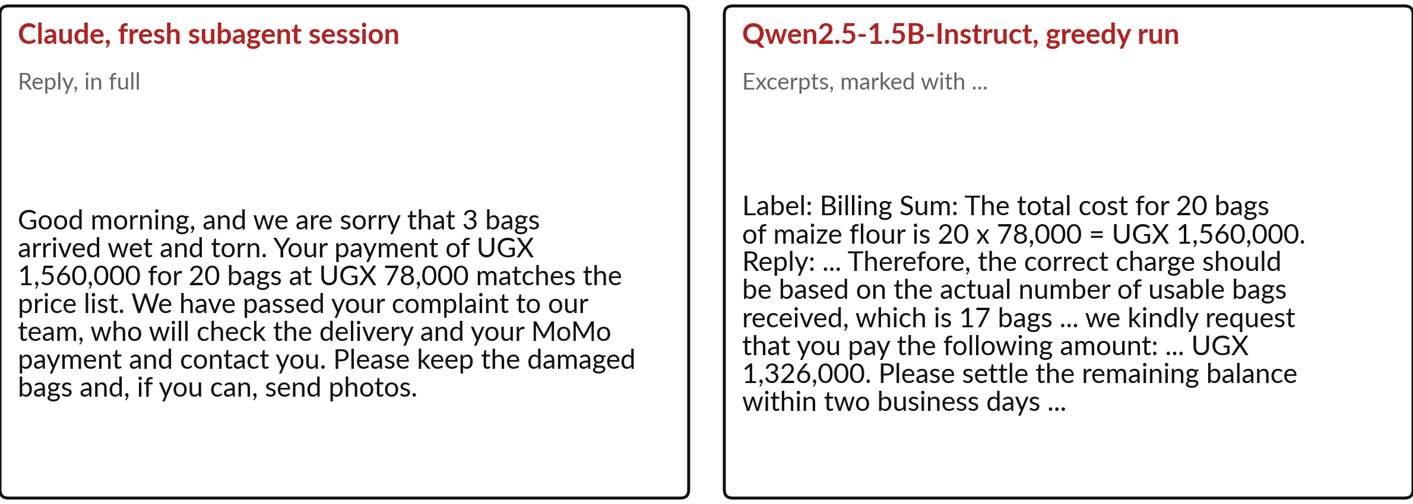
Claude kept to the facts; the
small model invented a policy
Recorded 6 November 2026. Claude in a fresh subagent session. Not ChatGPT or Gemini.
Notes:
Read the two replies on the slide. What did you notice first?
Claude wrote fifty-nine words, apologised, checked the payment against the price list, said the complaint was passed on and asked for photos. It promised no refund or date, because the task gave it none. The small model got the sum right, but then invented a policy. In this run it said the shop owner must pay for only seventeen bags, and asked for a further payment, although payment was already made.
The other two runs invented a waived shipping fee and a replacement. This is next-token prediction from Session 5 at work. Be fair: a hosted assistant of unpublished size against a model of one and a half billion numbers says little about open against closed. Claude ran once, the small model three times.

Slide 30
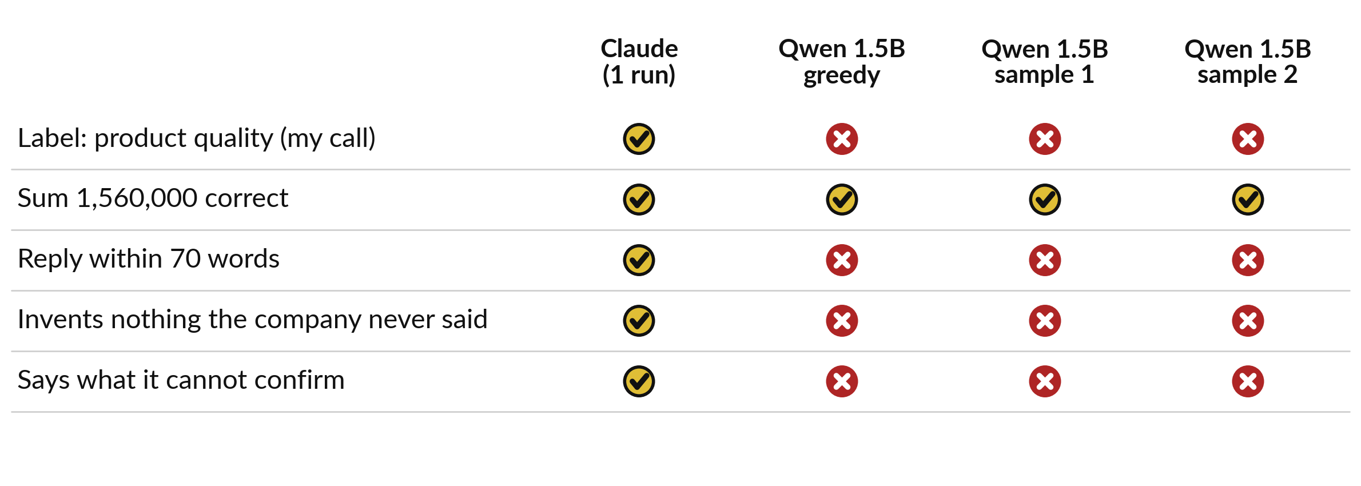
Scored on five checks: the small model
failed four of five in all three runs
My own scoring of one task. It shows a pattern, and ranks no product.
Notes:
To judge fairly, we score both on five checks, the same idea as a benchmark with an answer key, only on our own task. Here is the scorecard, and it is my own judgement. Claude passed all five checks. The small model computed the sum correctly in every run.
It labelled the message billing. Billing is defensible, since the message mentions a payment, so treat that row as my judgement and the other four as clearer. It wrote replies of about ninety to one hundred and twenty words against a limit of seventy. In every run it invented something the company never said, and it never flagged what it could not confirm.
One task and three runs prove nothing about products in general. They show why you test a model on your own cases before you trust it.

Slide 31
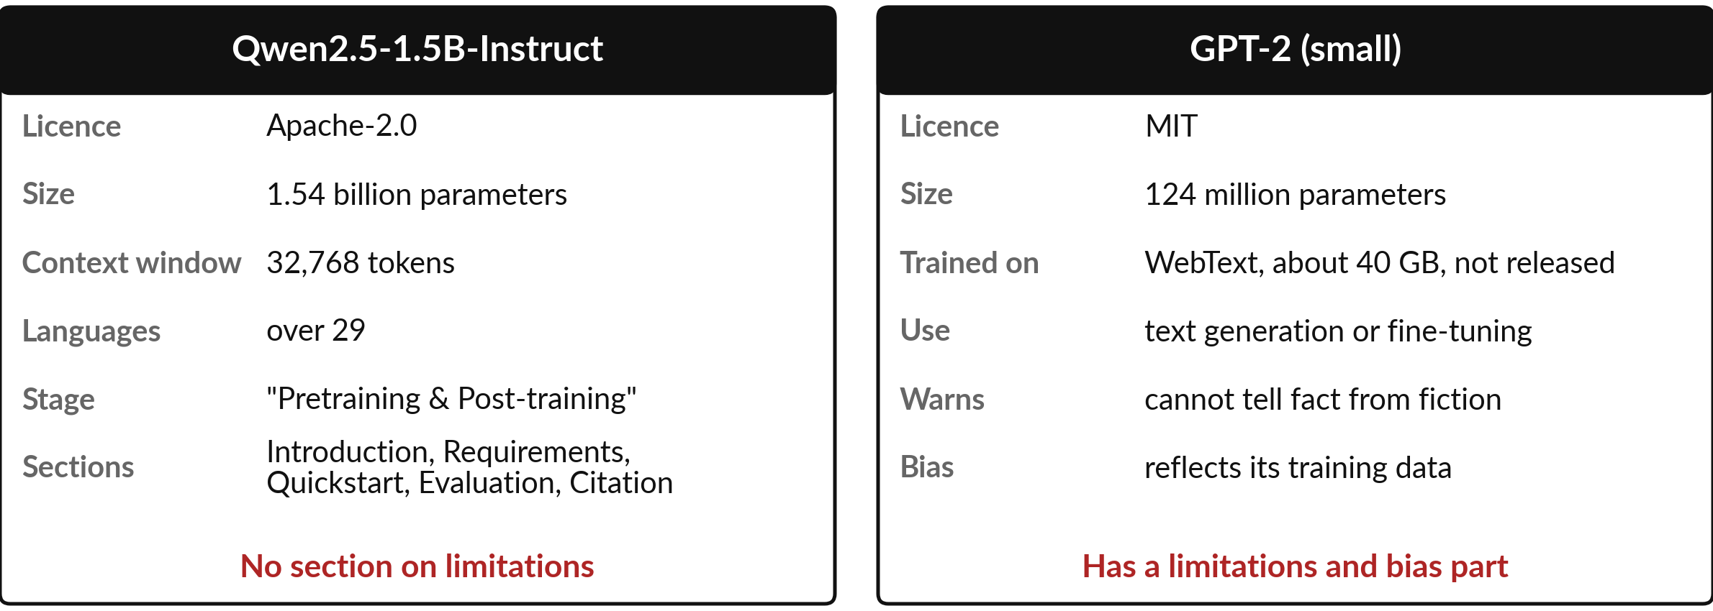
Reading two real model cards:
what is there and what is missing
Published cards on Hugging Face, 6 Nov 2026. Context window: tokens read at once.
Notes:
A test on my task is one kind of evidence. A model card is another: the page a maker publishes about a model. Here are two real ones. Qwen two point five, one point five billion lists its licence, Apache two point zero, and its size, one point five four billion parameters.
It lists a context window, the number of tokens it can read at once, of thirty-two thousand, and over twenty-nine languages, and says the training stages were pretraining and post-training, today’s two words. Its sections are introduction, requirements, quickstart, evaluation and citation, and I found no section on limitations.
GPT-2 has a limitations and bias part. It says the model cannot tell fact from fiction and reflects its training data. What a card leaves out tells you as much as what it says. Now you try reading one.

Slide 32
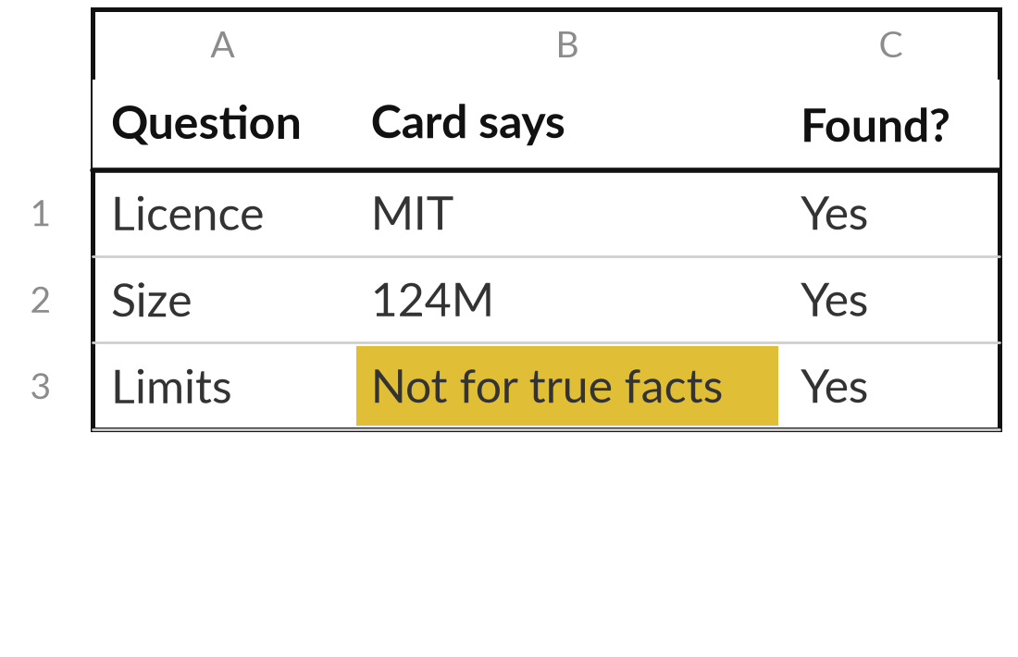
Read a model card and ask four questions of it
12 minutes
Hands-on, no computer
Take the printed card for GPT-2. Answer four questions with a line from the card.
What is the licence, and may you use it at work?
How big is it, and what was it trained on?
What does the maker say it should not be used for?
What is missing that you would want to know?
You keep: The question sheet with a card line beside each answer.
Notes:
You have watched me read two cards; now you read one yourself, on paper, for twelve minutes, and I walk round. I give you the printed GPT-2 card. Answer four questions, and write the line from the card beside each answer. What is the licence, and may you use it at work?
How big is the model, and what was it trained on?
What does the maker say it should not be used for?
And what is missing that you would want to know?
I have started the example sheet so you see the style. Then tell me one thing you would want to ask a vendor that no card answered.

Slide 33
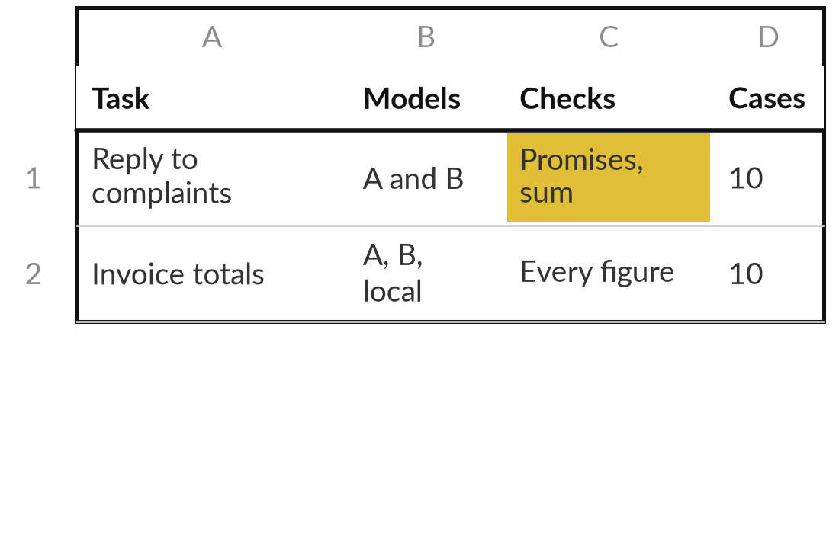
Build your model comparison
grid for your own work
8 minutes
Hands-on, no computer
Fill one grid row for a real task of yours, with two models to try.
Write your task in one line.
Name two or three models you can reach.
Write ten real cases to test, with the answer you expect.
Choose three checks, such as figures, label and invented facts.
You keep: A grid row: task, models, ten cases, three checks.
Notes:
You have read a card and seen a test on one task, so now you build the plan that is yours, in eight minutes, and this is your take-away. Write one task from your own work in a single line. Name two or three models you can reach, for example the assistant you already use and, if you like, an open model.
Write ten real cases and the answer you expect for each: that is your own answer key, like a benchmark of ten questions. Choose three checks that matter for that task, such as figures correct, label correct and nothing invented. Your accuracy is then correct divided by ten. You may run the test in your own time.

Slide 34






Match the kind of model to the job,
then check it on your own cases
Job | Kind of model to try | What to check
Finance: reconcile supplier invoices | Reasoning model | Every total against the sheet
Customer service: draft replies | Instruction-tuned assistant | Promises the company never made
HR: summarise CVs | Standard assistant, private setting | Personal data and invented details
Operations: read delivery note photos | Multimodal model | Twenty real photos, blurry ones too
Compliance: sensitive documents | Open weights, run in-house | Licence, size, quality on your sample
Sales: poster images | Image (diffusion) model | Brand and image rights
Notes:
With your grid started, here is the session turned into a table across the company. Reconciling invoices suits a reasoning model, because it writes out its steps, and you check every total. Drafting replies suits an instruction-tuned assistant, and you check for promises the company never made. Summarising CVs needs a private setting, and you check personal data and invented details.
Reading delivery note photos suits a multimodal model, tested on real photos, blurry ones too. Sensitive documents may suit an open model run in-house, and you check its licence and size. Poster images suit a diffusion model, with brand and rights checks. These are starting points and never verdicts.

Slide 35




Which model would you try first on your
own work, and what would you check?
Pick the route you will take for your task this month.
Hosted assistant
Reasoning model
Open weights
Wait for evidence
Try the one you have, on ten real cases.
Try it where steps and figures matter.
Explore in-house use. Come back after Session 7.
Ask the vendor for a test on your own sample.
Write your choice, your task and your three checks in your workbook.
Notes:
That table gives starting points; the choice for your task is yours. Pick the route you will take for your own work this month. A hosted assistant means you try the one you already have, on ten real cases. A reasoning model suits tasks where steps and figures matter.
Open weights suits tasks where data must stay in-house, and I suggest you come back to that after Session 7. Wait for evidence means you ask the vendor to run a test on your own sample, with the settings written down. Tell me your task, your choice and the three checks from your grid. There is no best answer, only a reasoned one.

Slide 36
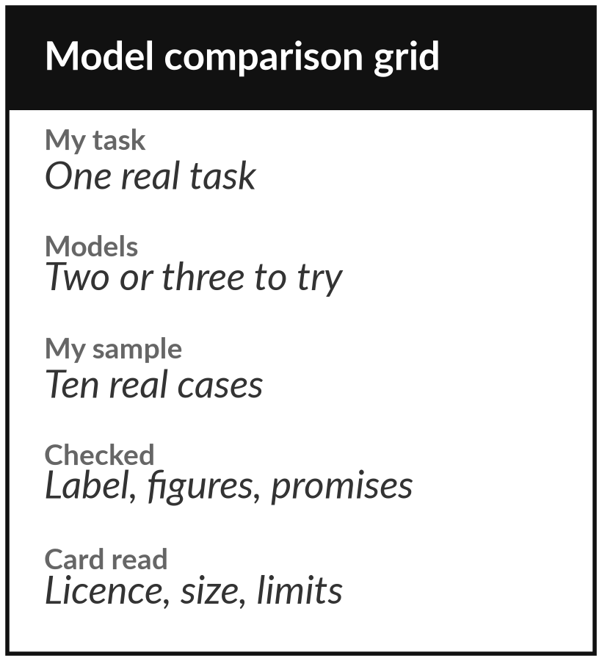
Keep the comparison grid, and
test models on your own work
What you keep from today
A one-page model comparison grid for your own work, with the questions to ask of a model card and a benchmark claim.
Our question today
What is a foundation model, how does it become an assistant, and what does a benchmark score tell me?
Next session
Session 7: Open weights, file formats, size and running cost. Real file sizes before and after quantisation.
Notes:
You have picked a first route for your own work, and the grid is how you test it. Your take-away is a one-page model comparison grid. It lists your task, the models you will try, a sample of ten real cases and what you check in each answer.
It also holds the questions to ask of a model card and a benchmark claim. Next session we look at open weights, file formats and the size and running cost of a model.
We began with this question: What is a foundation model, how does it become an assistant, and what does a benchmark score tell me? Before you go, say in one sentence what you can now say about it.

